Slide 1
Feature Learning and Importance Scoring on Incomplete Anomaly Datasets
Bachelor Thesis Initial Presentation
Julian Hoffmeister
20/07/2022
Research Supervisor:
Andreas Lohrer
Responsible Professor:
Prof. Dr. Peer Kröger

Slide 2
Contents
Introduction
Related Work
Research Questions
Concept
Evaluation and Metrics
Schedule

Slide 3
Introduction
How can we fill the missing values in order to optimize cluster performance?
ID | A | B
1 | 1 | 7
2 | 3
3 |  | 3
4 | 2
5 | 1 | 6
6 | 2 | 5
7 | 2 | 6
8 | 3 | 7
9 | 6 | 2
10 | 7
11 | 7 | 3
12 | 8 | 1
13 | 6 | 3
14 | 7 | 2
15 | 7 | 4
16 |  | 1
B
A

Slide 4
Introduction
Cluster Performance?
Clearly distinguishable clusters
Few or no outliers
ID | A | B
1 | 1 | 7
2 | 3 | 6
3 | 8 | 3
4 | 2 | 7
5 | 1 | 6
6 | 2 | 5
7 | 2 | 6
8 | 3 | 7
9 | 6 | 2
10 | 7 | 3.5
11 | 7 | 3
12 | 8 | 1
13 | 6 | 3
14 | 7 | 2
15 | 7 | 4
16 | 7 | 1
B
A

Slide 5
Introduction
Cluster Performance?
Clearly distinguishable clusters
Few or no outliers
ID | A | B
1 | 1 | 7
2 | 3 | 2
3 | 1 | 3
4 | 2 | 2
5 | 1 | 6
6 | 2 | 5
7 | 2 | 6
8 | 3 | 7
9 | 6 | 2
10 | 7 | 1
11 | 7 | 3
12 | 8 | 1
13 | 6 | 3
14 | 7 | 2
15 | 7 | 4
16 | 1 | 1
B
A

Slide 6
Introduction
Cluster Performance?
Blurry borders
outliers
ID | A | B
1 | 1 | 7
2 | 3 | 4
3 | 4 | 3
4 | 2 | 3
5 | 1 | 6
6 | 2 | 5
7 | 2 | 6
8 | 3 | 7
9 | 6 | 2
10 | 7 | 5
11 | 7 | 3
12 | 8 | 1
13 | 6 | 3
14 | 7 | 2
15 | 7 | 4
16 | 7 | 1
B
A

Slide 7
Introduction
Learn filling values by optimizing cluster performance metrics
ID | A | B
1 | 1 | 7
2 | 3 | ?
3 | ? | 3
4 | 2 | ?
5 | 1 | 6
6 | 2 | 5
7 | 2 | 6
8 | 3 | 7
9 | 6 | 2
10 | 7 | ?
11 | 7 | 3
12 | 8 | 1
13 | 6 | 3
14 | 7 | 2
15 | 7 | 4
16 | ? | 1
B
Missing Values
Cluster Performance
A

Slide 8
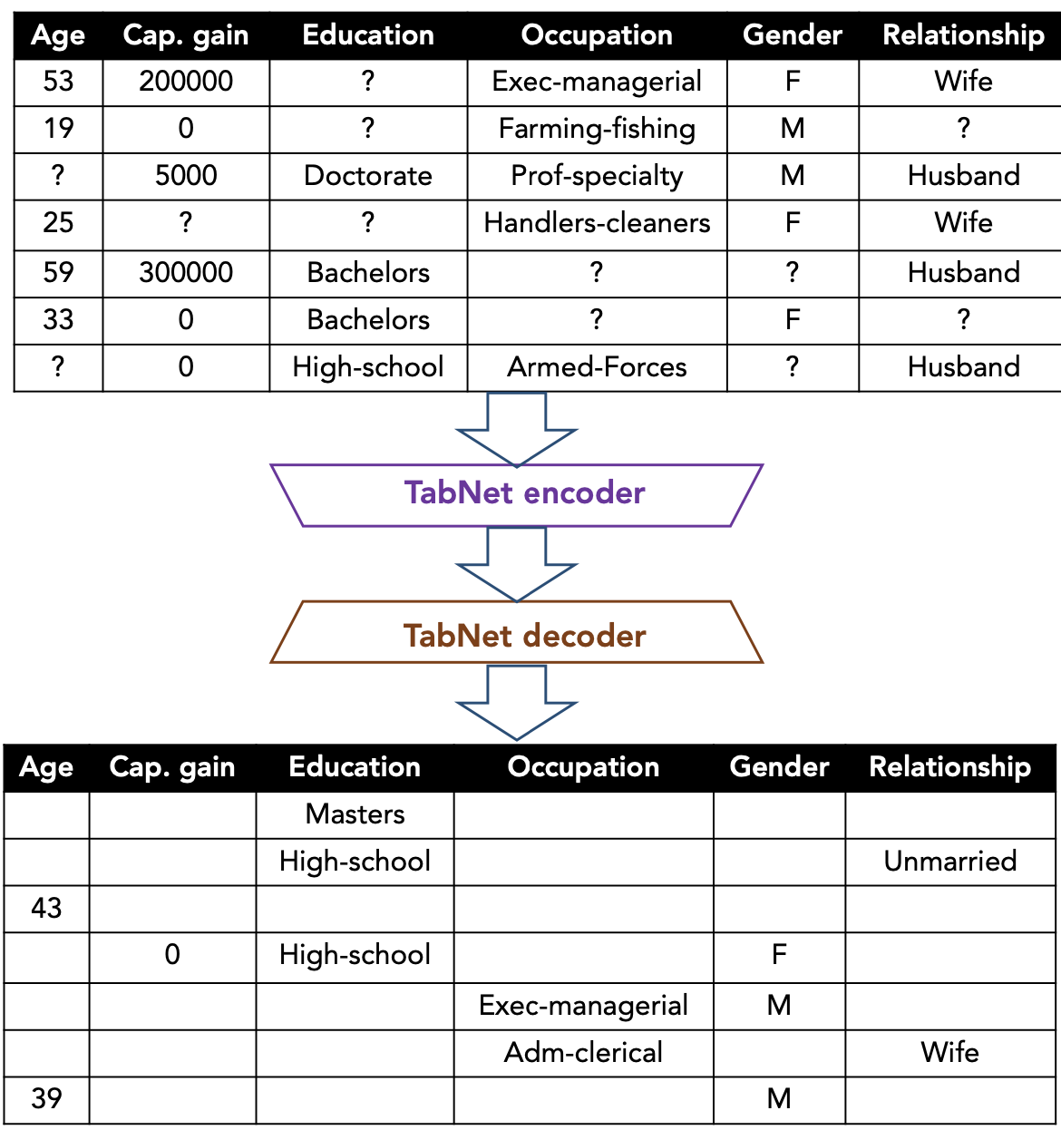
Learning Missing Values
TabNet: S. Ö. Arik, T. Pfister. 2020. TabNet: Attentive Interpretable Tabular Learning. arXiv:1908.07442v5
Transformer architecture
Attentive Transformers
Feature Transformers
Sequential attention mechanism
Used here to predict missing values in tabular data
Interpretability: TabNet attention matrices could help to derive feature importance and improve explainability
Notes:
Classical filling strategies such as heuristics (mean, median, …) or distribution based do not fullfill the “learning” criteria

Slide 9

Research Questions
RQ 1
How is it possible to improve clustering of missing values/dimensions datasets with model based filling strategies?
1
2
n
 |  | . . .
RQ 2
How does the number of dimensions influence the cluster/outlier results?
RQ 3
How is it possible to make model based filling strategies explainable?

Slide 10
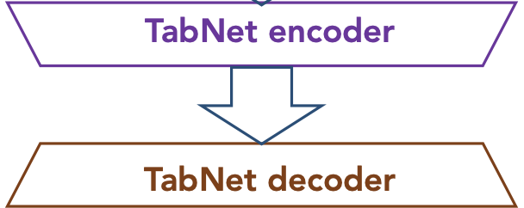
Concept – RQ1
How is it possible to improve clustering of missing values/dimensions datasets with model based filling strategies?
3: Clustering:
e.g. DBSCAN with constant hyperparameters and different Datasets
Or DeepDPM:
advantage – learn from dataset, learn cluster amount k
But check before, if DeepDPM can handle missing values already
λ
2 Filling Strategy
1 Datasets
3 Full Datasets
4 Clustering
Custom loss
function
5 Performance Ratings

Slide 11
Concept – RQ2
How does the number of dimensions influence the cluster/outlier results?
λ
2 Filling Strategy
1 Datasets
3 Full Datasets
4 Clustering
n runs
randomly omit
x% of features
Custom loss
function
5 Performance Ratings
6 Feature importance
(derived from the impact of missing
features on the cluster performance)

Slide 12
Concept – RQ3
How is it possible to make model based filling strategies explainable?
λ
2 Filling Strategy
1 Datasets
3 Full Datasets
4 Clustering
Custom loss
function
use TabNet input (missing value datasets) and output (filled dataset) to create a decision tree
5 Performance Ratings

Slide 13
Evaluation and Metrics
RQ 1
Baseline: cluster performance after 1 step (no performance optimisation)
Comparison value: cluster performance after optimisation loops
1
2
n
RQ 2
Cluster results: changes in cluster performance based on # of dimensions
Outlier results: changes in outlier metrics (variance, Kurtosis)
 |  | . . .
RQ 3
To be defined
Verification of decision tree by domain experts?

Slide 14
Schedule
1
2
3
4
5
6
7
8
9
10
11
12
13
14
15
16
17
18
19
20
Literature research
Concept
Concept Implementation
Experiments
Thesis Writing
Review and Adaption
Talks & Presentation
Buffer

Slide 15
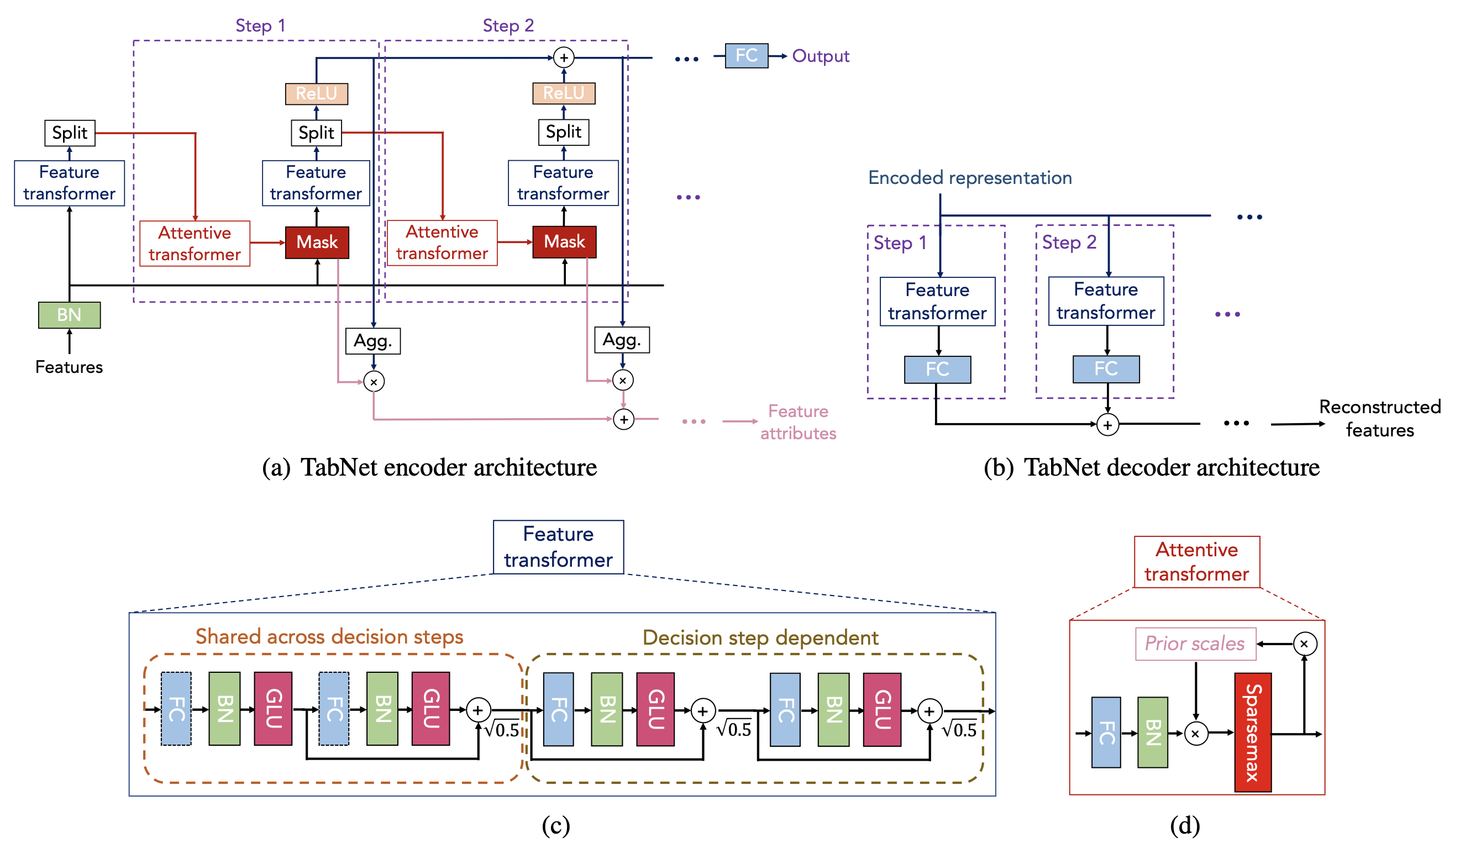
TabNet Architecture
Split:
Attention goes to next step
Predictions are added up

Slide 16
TabNet Architecture

Slide 17
Concept
Datasets
Degrees of freedom:
Source (real vs toy)
Datasets (number)
Distribution of MVs (per feature: completely random, not random, …)
Use existing datasets and create missing values (with configurable degree)
Use real world datasets with missing values

Slide 18
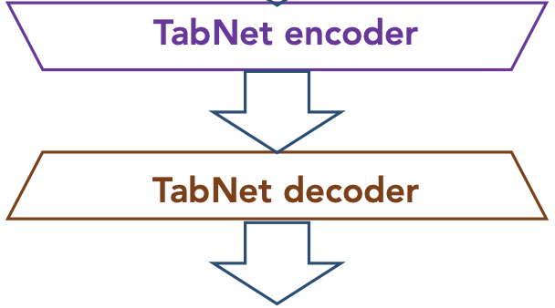
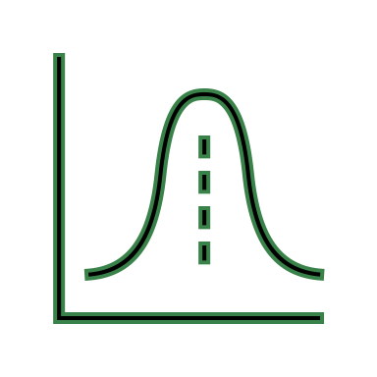
Concept
Models
Distributions
Apply filling strategies to create multiple datasets in different versions
E.g. TabNet,
VIME
Degrees of freedom:
Strategies
Parameters
Heuristics
mean
random
…

Slide 19
Concept
Models
Heuristics
Distributions
characterize features
outlierness,
(co)variance,
correlation, etc.

